Slide 1
Fall 2019 Committee Meeting
Nov 22, 2019

Slide 2
Overview of today
Updates and timeline for Chapter 1: Phyto Forecasting
Updates and timeline Chapter 2: Heterogeneity among reservoir continua
Overview of proposed Chapter 3
Discussion of Chapter 4 possibilities
Timeline for the next couple of years

Slide 3
Updates
Oral presentations
VA Drinking Water Forum (June 2019)
Ecological Society of America (August 2019)
Poster presentations
Ecological Forecasting Initiative (May 2019)
GLEON (November 2019)
Awards
GLEON Student Travel Award
Robert and Marion Patterson Biological Science Award
Accepted to SESYNC workshop in January

Slide 4
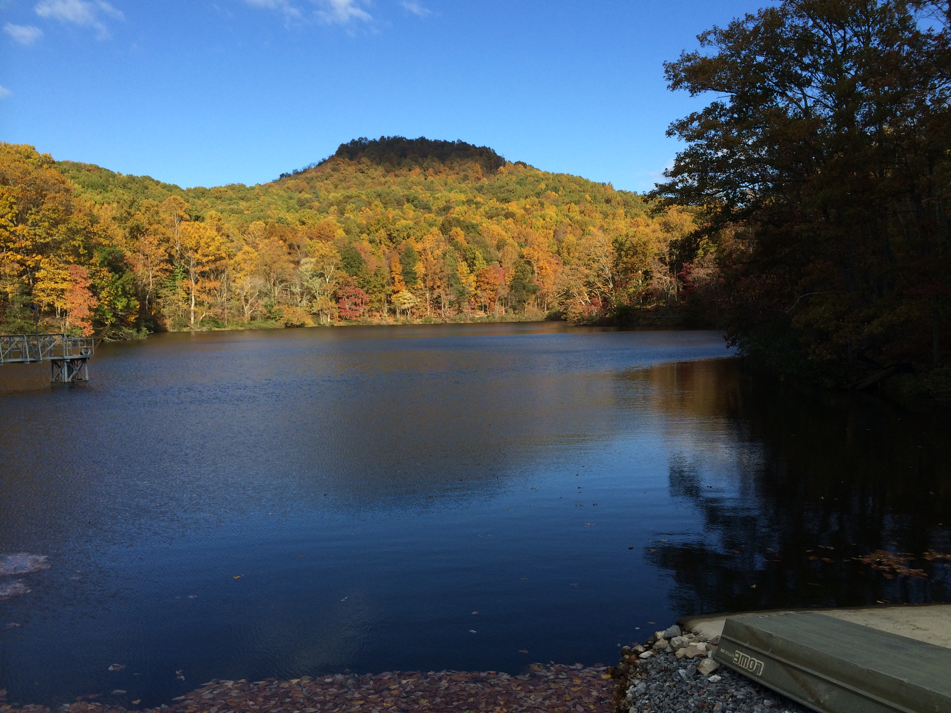
Chapter 1: Using an empirical approach to produce near-term iterative forecasts of chlorophyll-a in a drinking water reservoir

Slide 5
Chapter 1 Questions
Q1: How well can an empirical model and a process-based model hindcast and forecast near-term (14 days) algal biomass (chlorophyll-a)?

Slide 6
Chapter 1 Questions
Q1: How well can we forecast near-term algal biomass (chlorophyll-a) using an empirical model approach?
Q2: What are the dominant drivers of uncertainty in our forecasts?

Slide 7
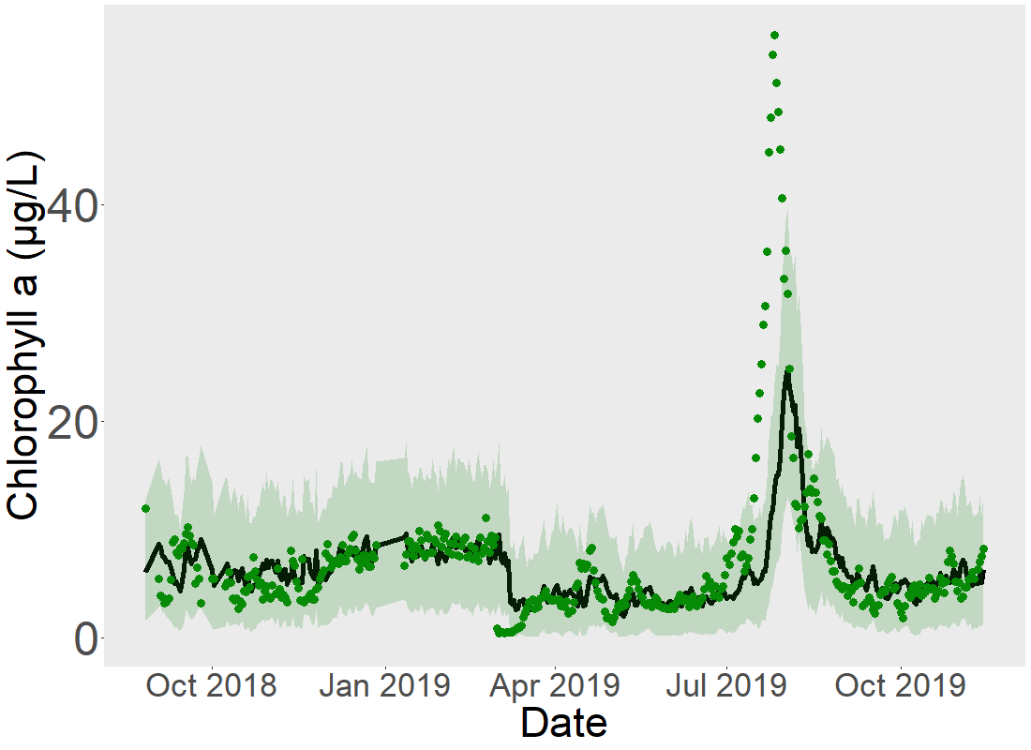
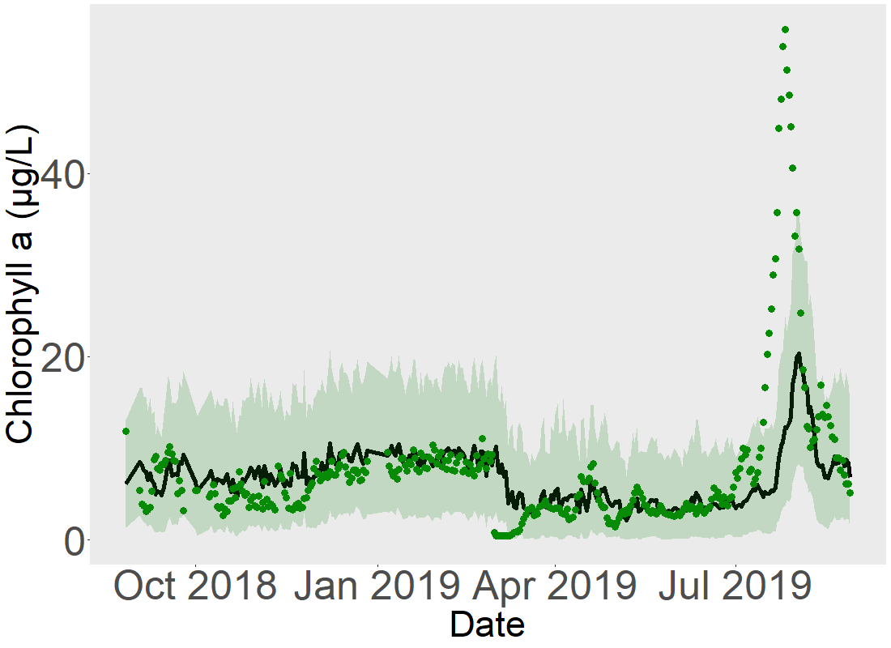
Q1: How well can we forecast near-term algal biomass (chlorophyll-a) using an empirical model approach?
Observed
Forecast mean
95% Confidence Interval
Total R² = 0.38
Total RMSE = 6.5 μg/L
Non-bloom* R² = 0.44
Non-bloom* RMSE = 1.9 μg/L
*outside dotted lines

Slide 8
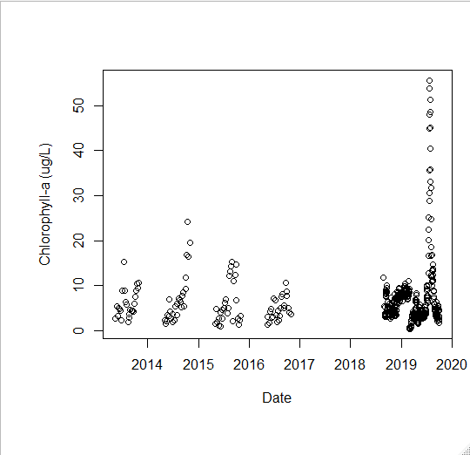
2019 bloom far outside historical envelope of training data
Notes:
Double check that the exo data is in ctd units

Slide 9
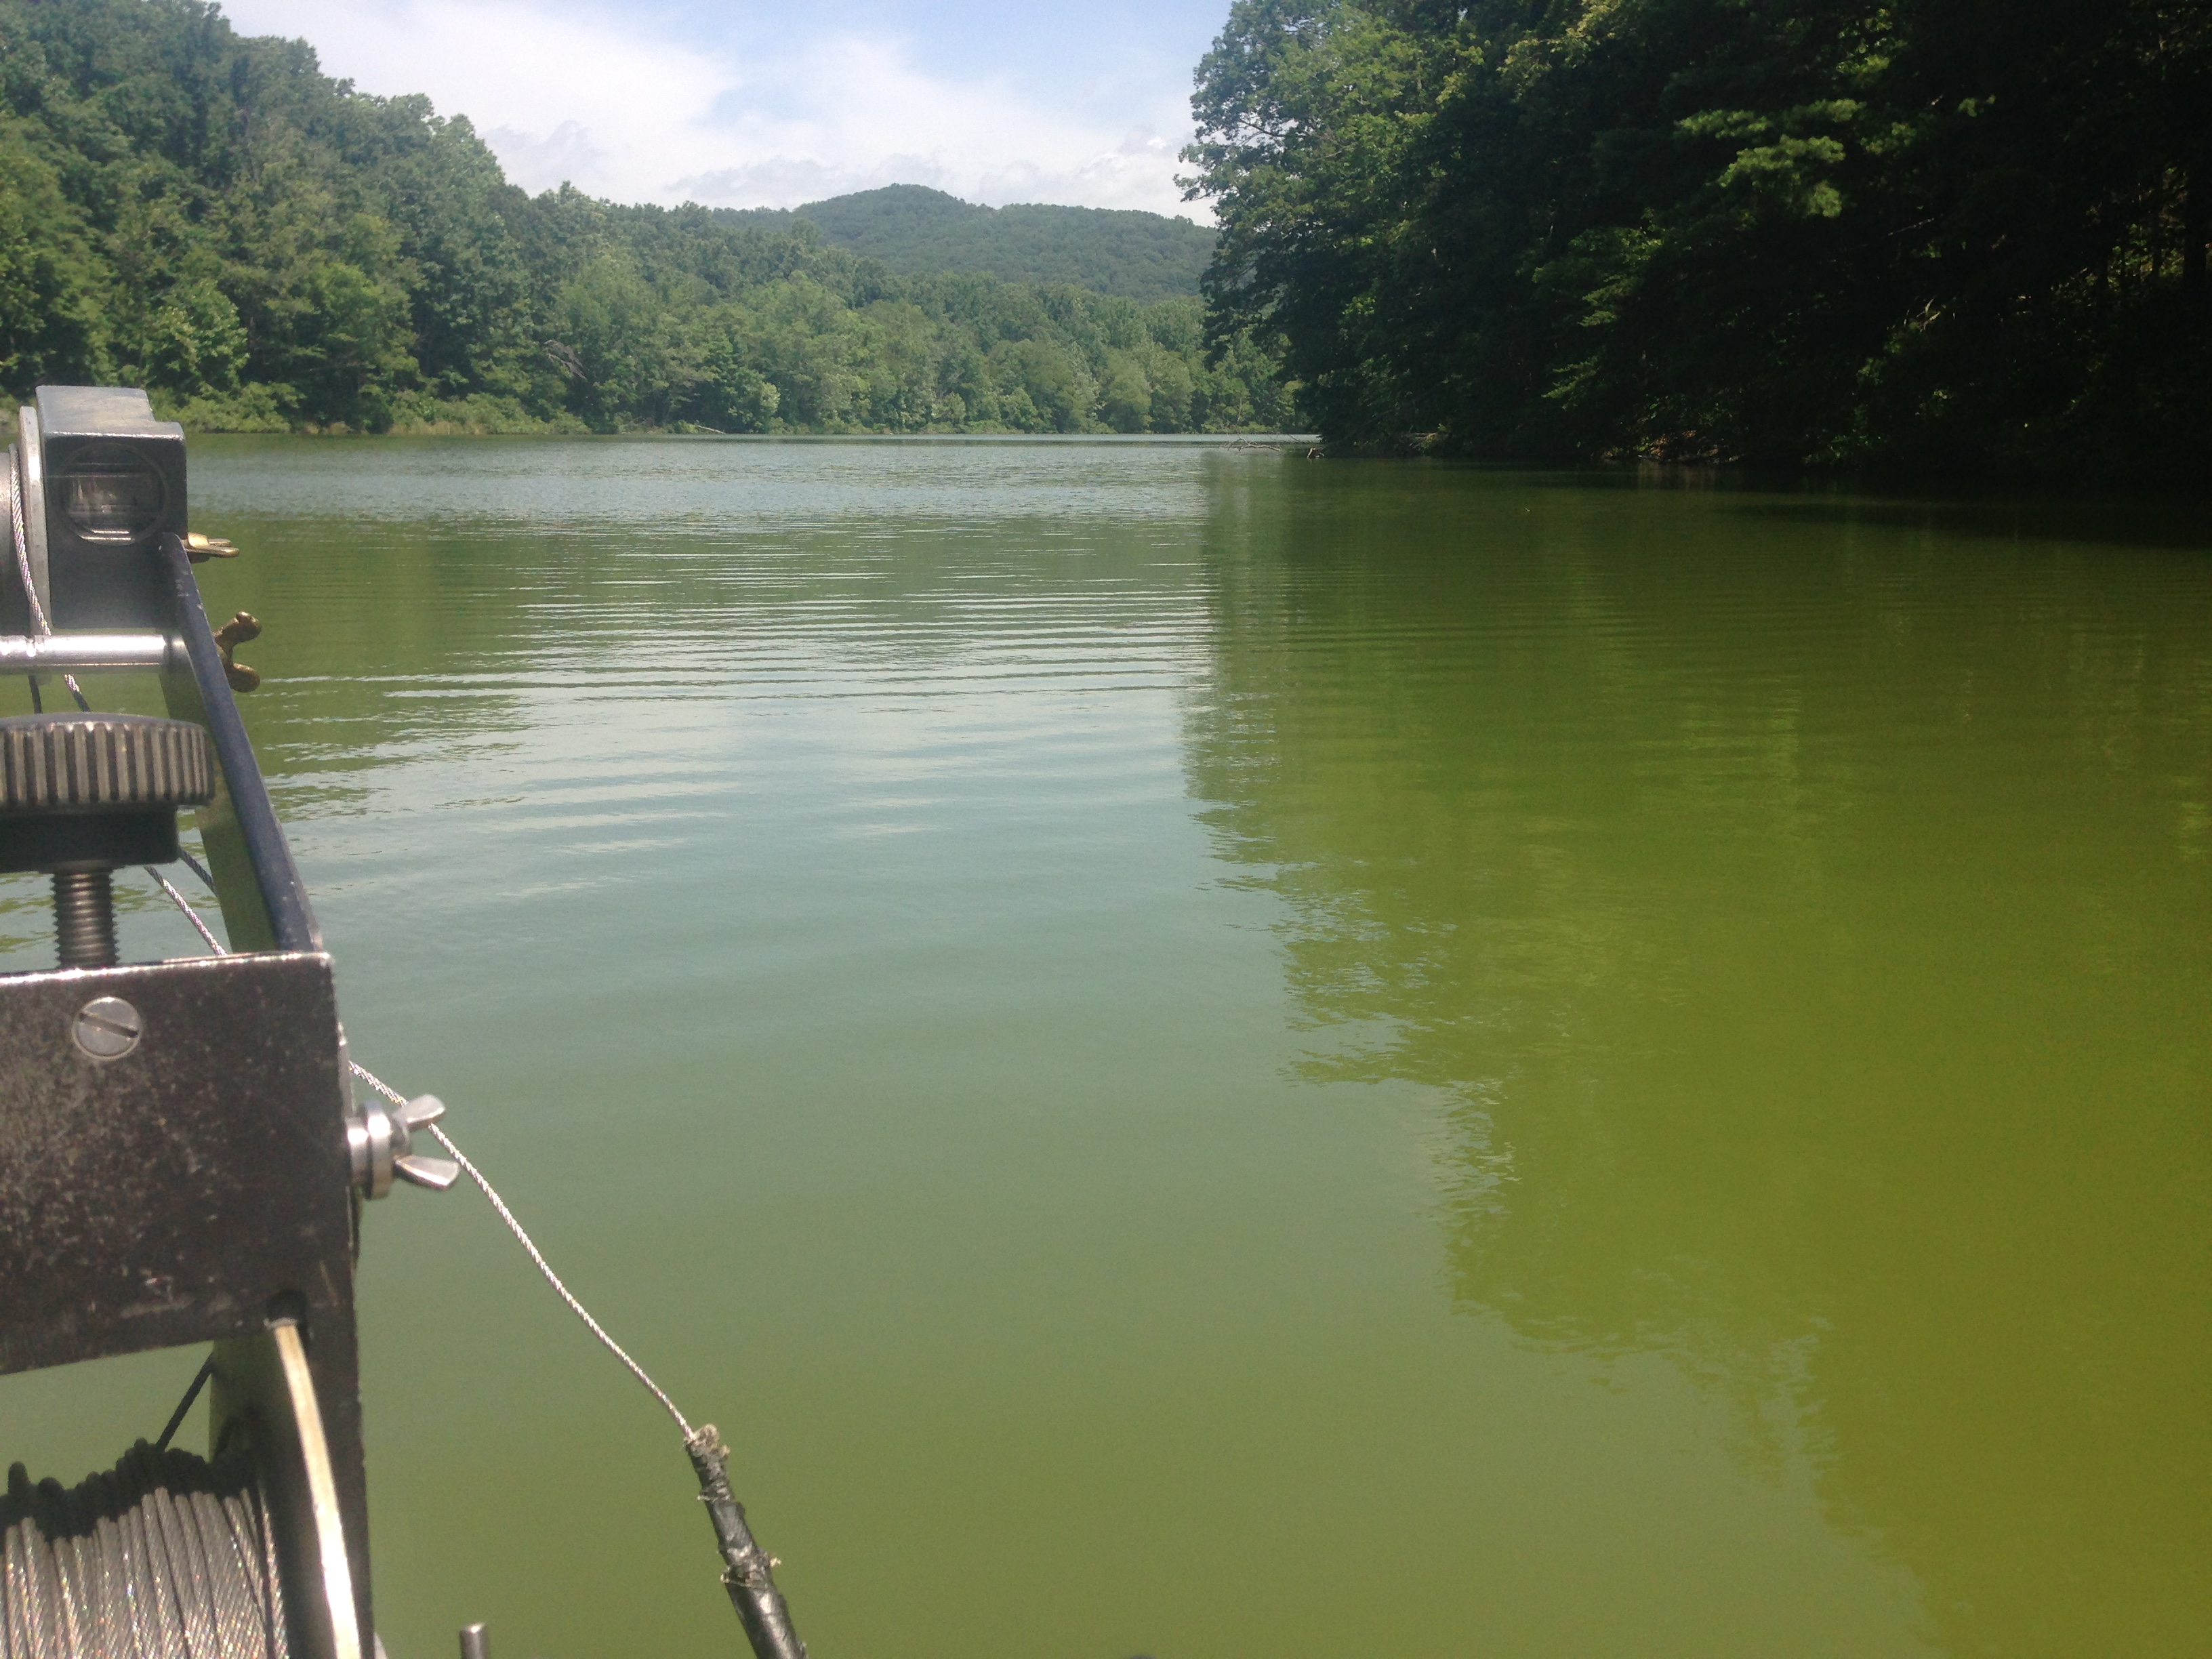
Q1: How well can we forecast algal biomass (chl-a) over a one-year period?
Null persistence model
Assumes next week’s algal biomass will be the same as this week’s
For a given day, the null model takes the observed chl-a data and adds process error for week 1 and week 2 forecasts

Slide 10
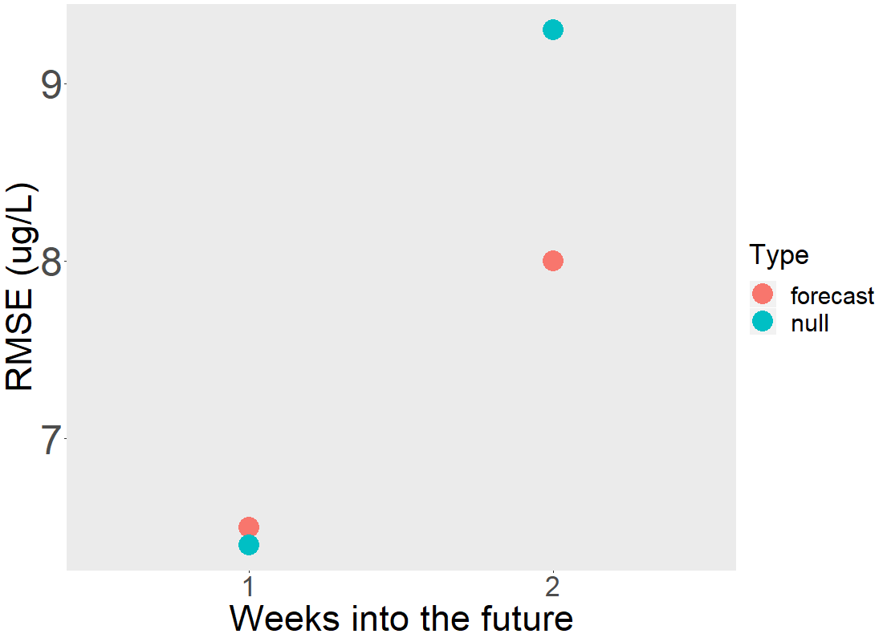
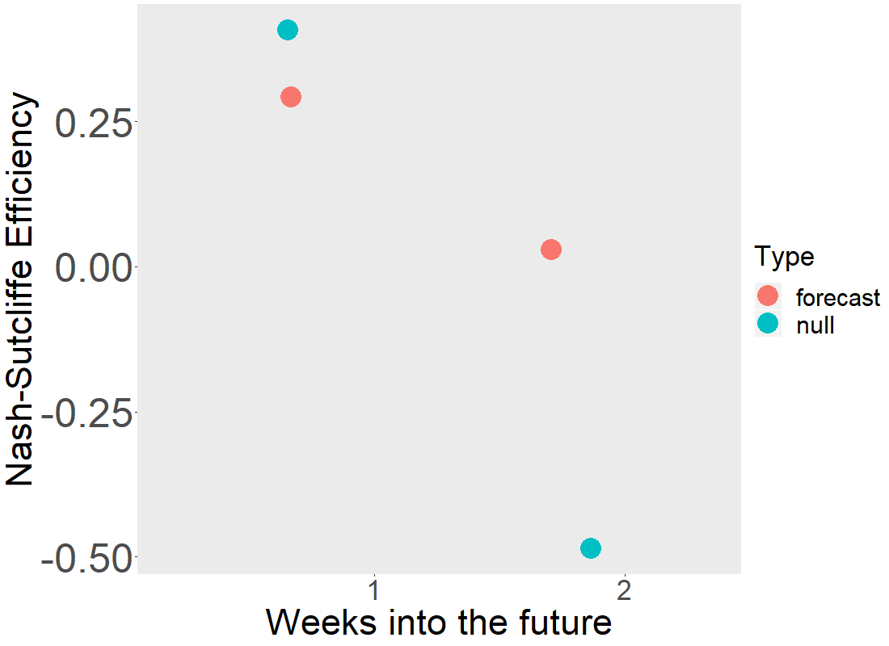
2-week ahead forecasts do much better than null model for entire time period
Notes:
NSE < 0 indicates that the observed mean is a better predictor than the model, or when the residual variance (described by the numerator in the expression above), is larger than the data variance (described by the denominator)

Slide 11
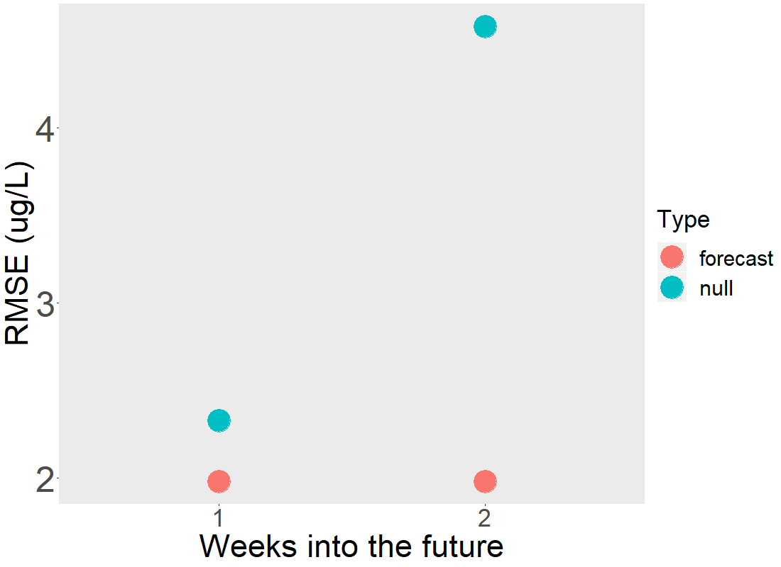
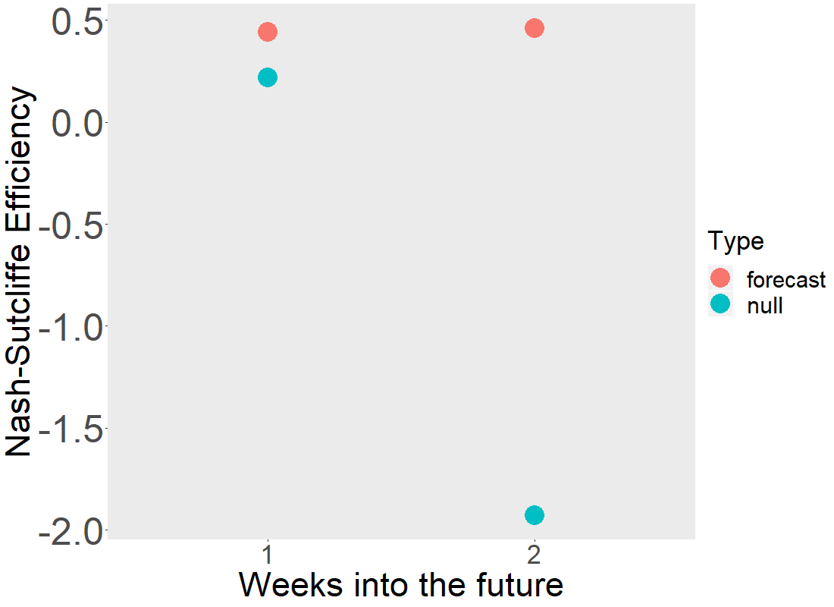
Outside of bloom period, forecast performs consistently and substantially better than null
Notes:
Also have kling gupta efficiency to look at

Slide 12



Q2: What are the dominant drivers of uncertainty in our forecasts?
Initial condition uncertainty
Sample from a normal distribution around the observed measurement
Discharge driver uncertainty
Forecasted discharge as an average of the past 5 years on the given day, sample from normal distribution of forecast
Chl-a_{t} = β₁ + β₂Chl-a_{t-1} – β₃Discharge_{t} – β₄Shortwave_{t} + Ɛ
Process uncertainty
Sample from a normal distribution of the model error
β_{x}
Parameter uncertainty
sample from a distribution of the mean parameter value
Meteorological driver uncertainty
21 NOAA forecast ensembles

Slide 13
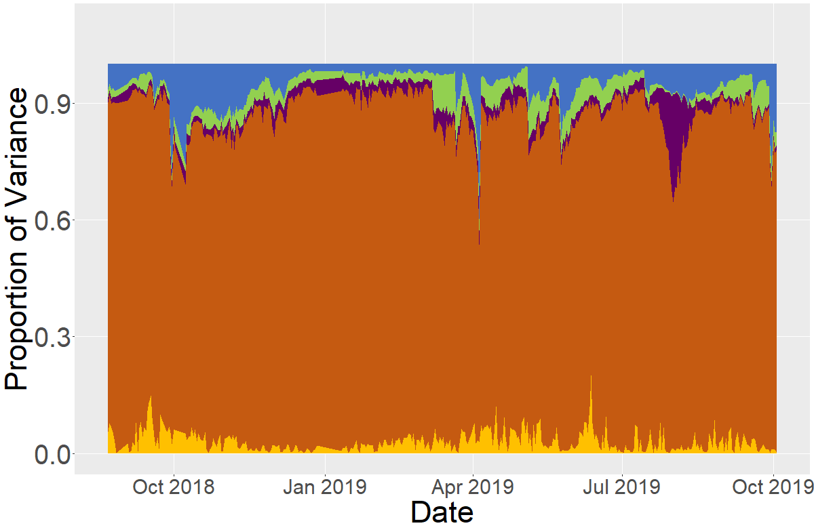
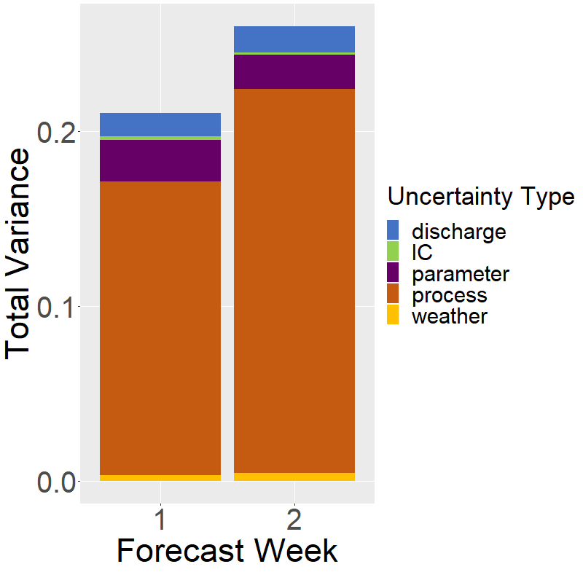
Relative proportion of uncertainty changes throughout the time series
Notes:
Add legend

Slide 14
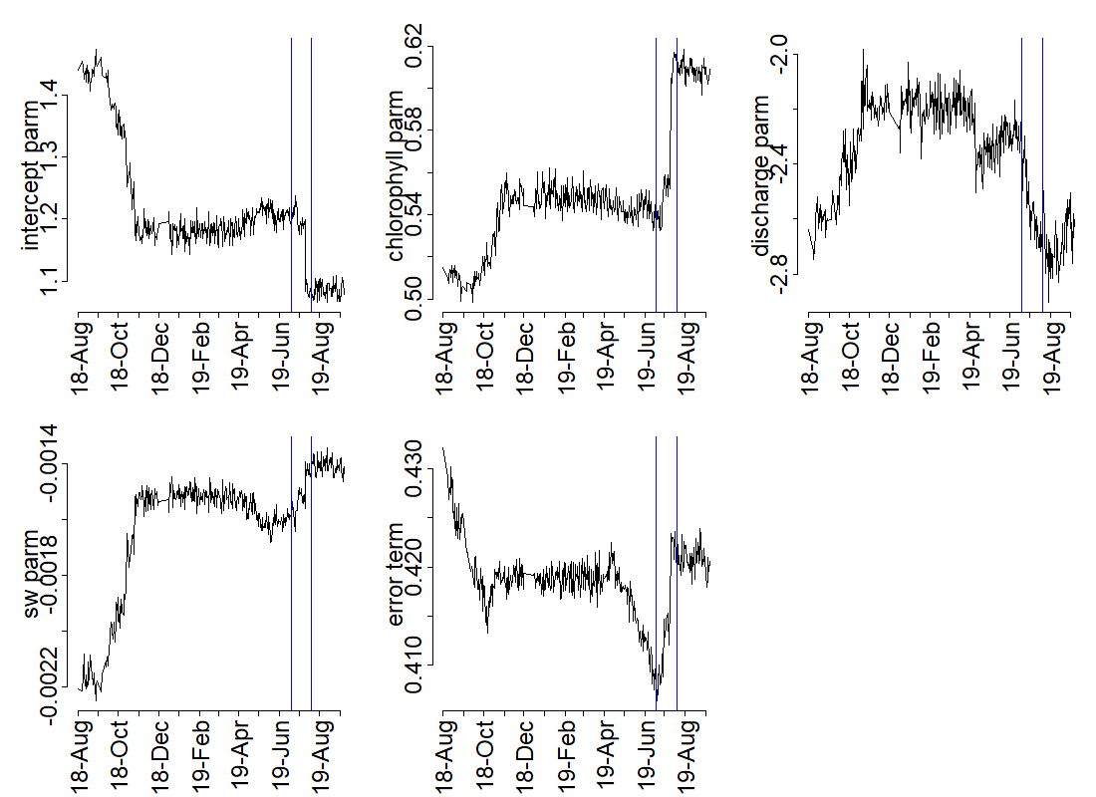
Parameter values change over time. All parameters change during July 2019 bloom
Notes:
How long should spinup period be? How to generate dataset for pre aug 2018 from bi-weekly dataset?

Slide 15
Next steps and timeline for ch 1
Improvements to the model (next 1-2 months)
Moving window for time series data assimilation
Fast and slow processes/models: fit high-frequency model
Wavelet analysis to determine dominant time scale
Early warning indicators: check for variability in data immediately before bloom?
Normalize driver data (subtract mean/sd) to determine relative importance
Include spin-up period
Writing
Outline/draft already in progress
Aim to submit to Ecological Applications by May 2020 (at latest!)

Slide 16
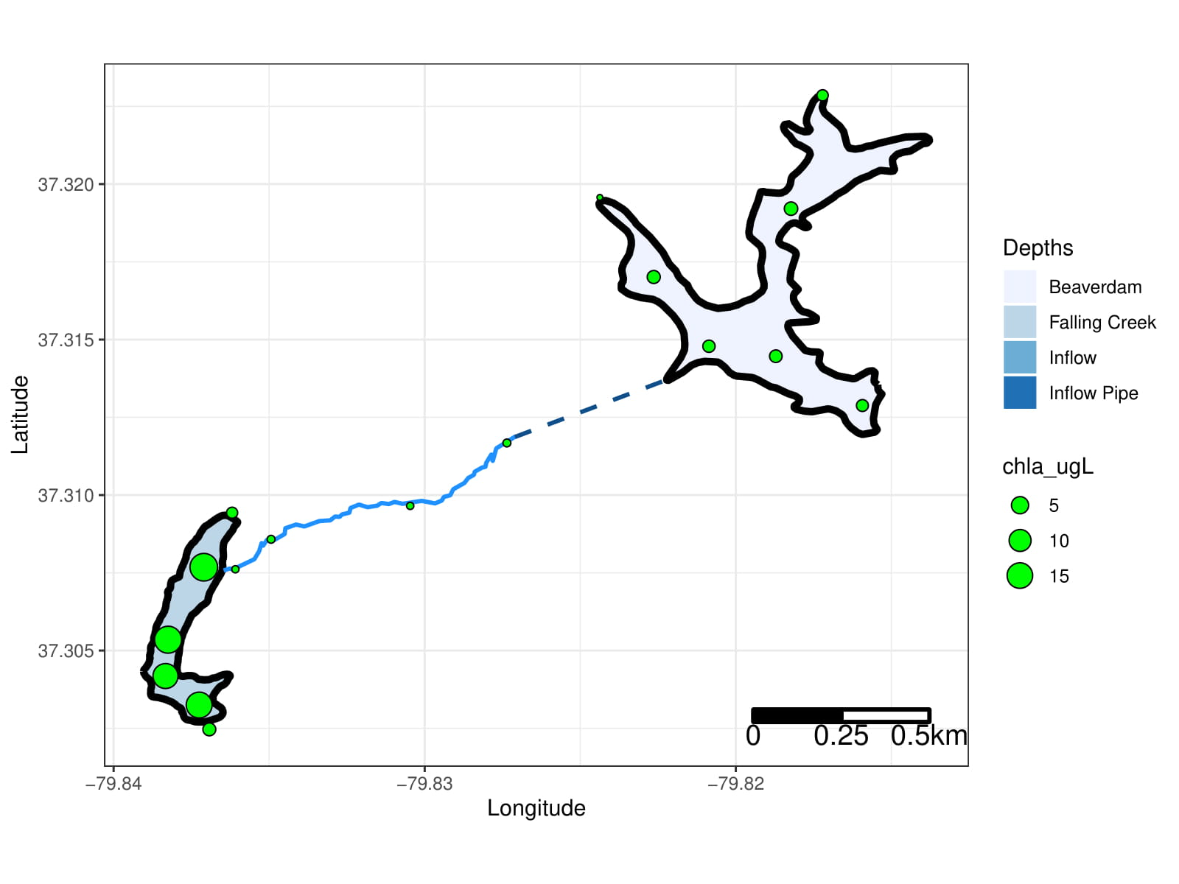
Chapter 2: Heterogeneity among reservoir continua
Q1: What is the longitudinal heterogeneity of nitrogen, phosphorus, and chlorophyll-a along a double reservoir continuum?
Q2: What are the drivers of heterogeneity among reservoir continua (i.e., residence time, internal loading)?
2 reservoirs
5 streams
17 sites total
6 sampling days

Slide 17
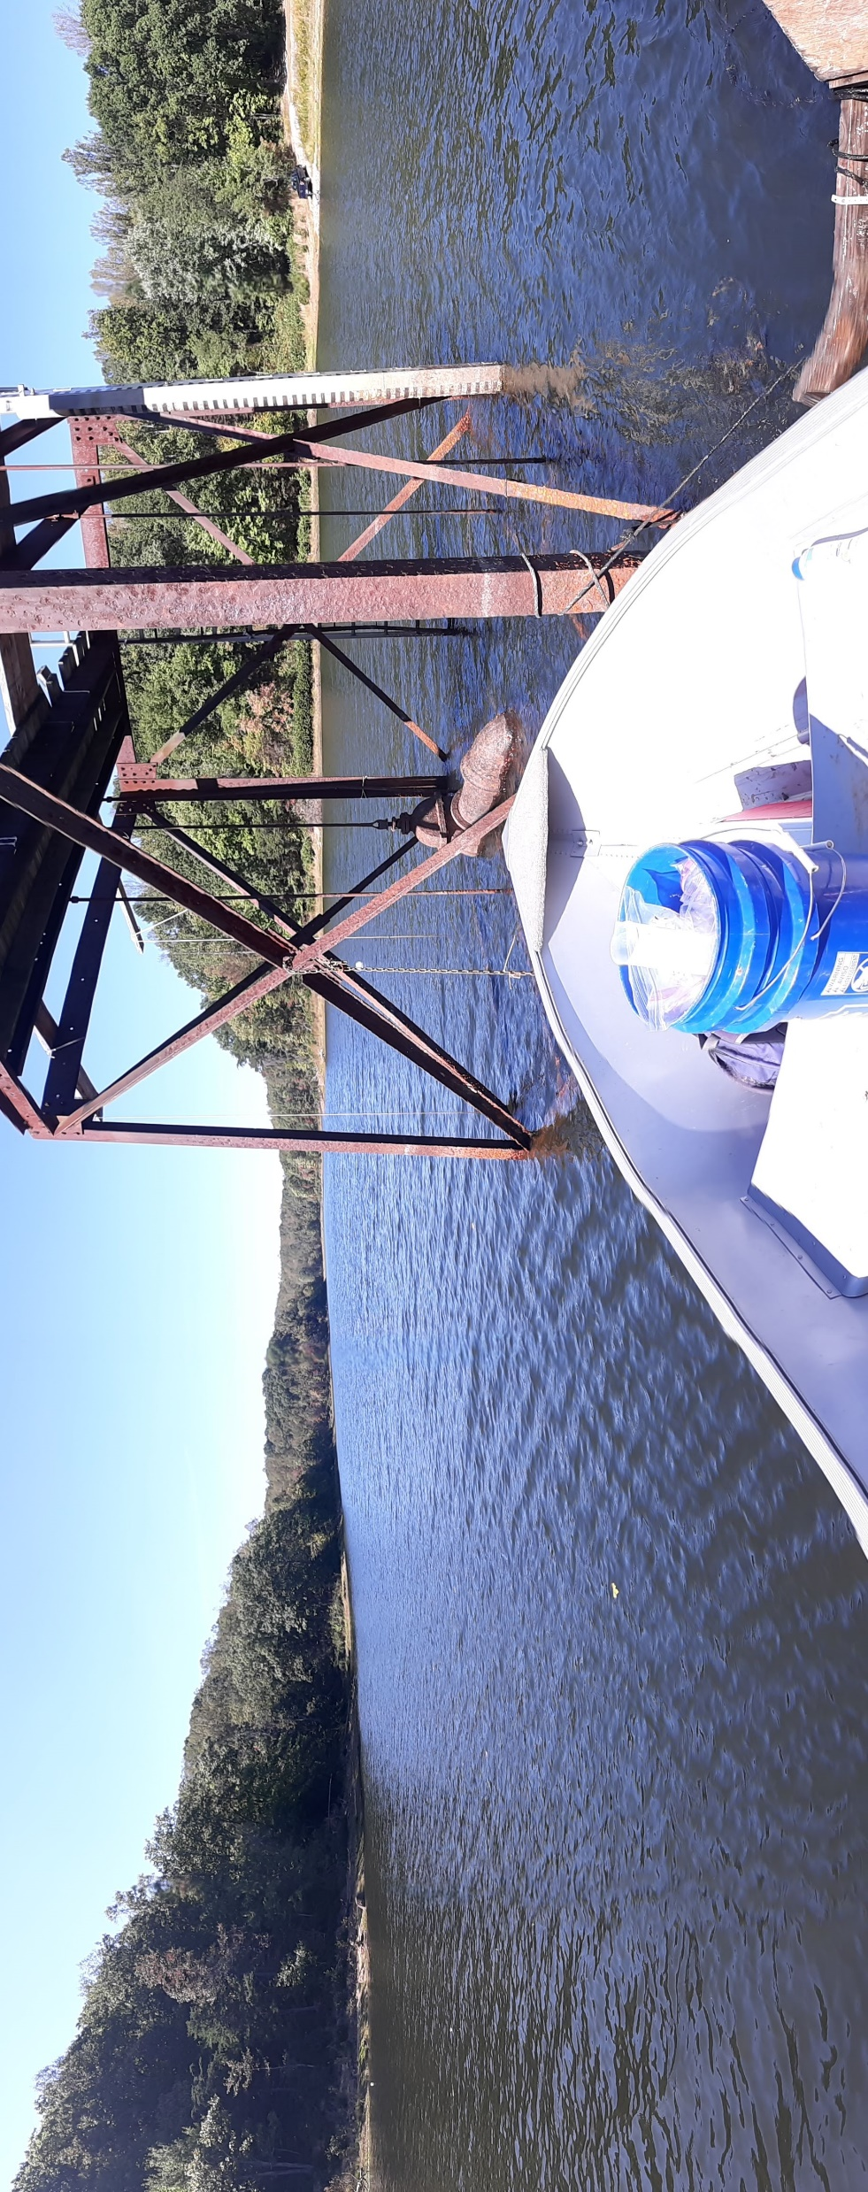
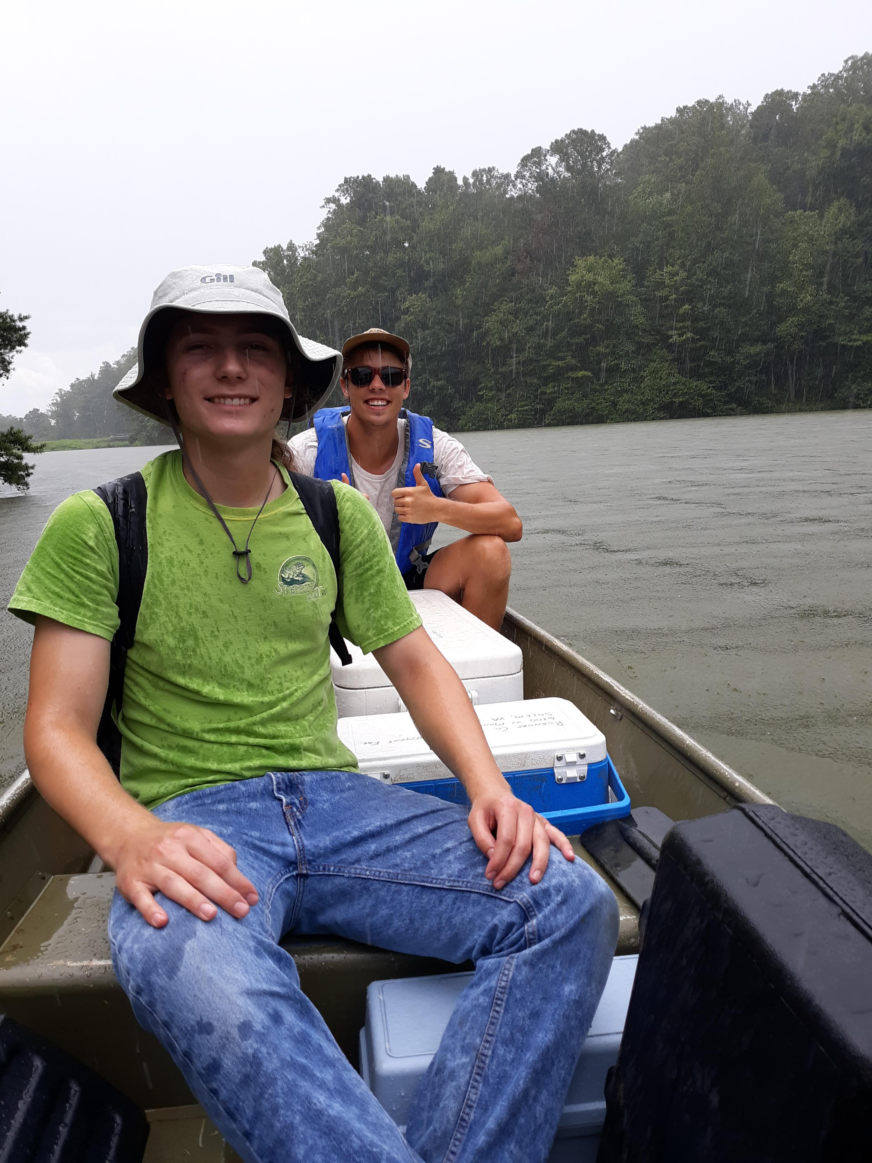
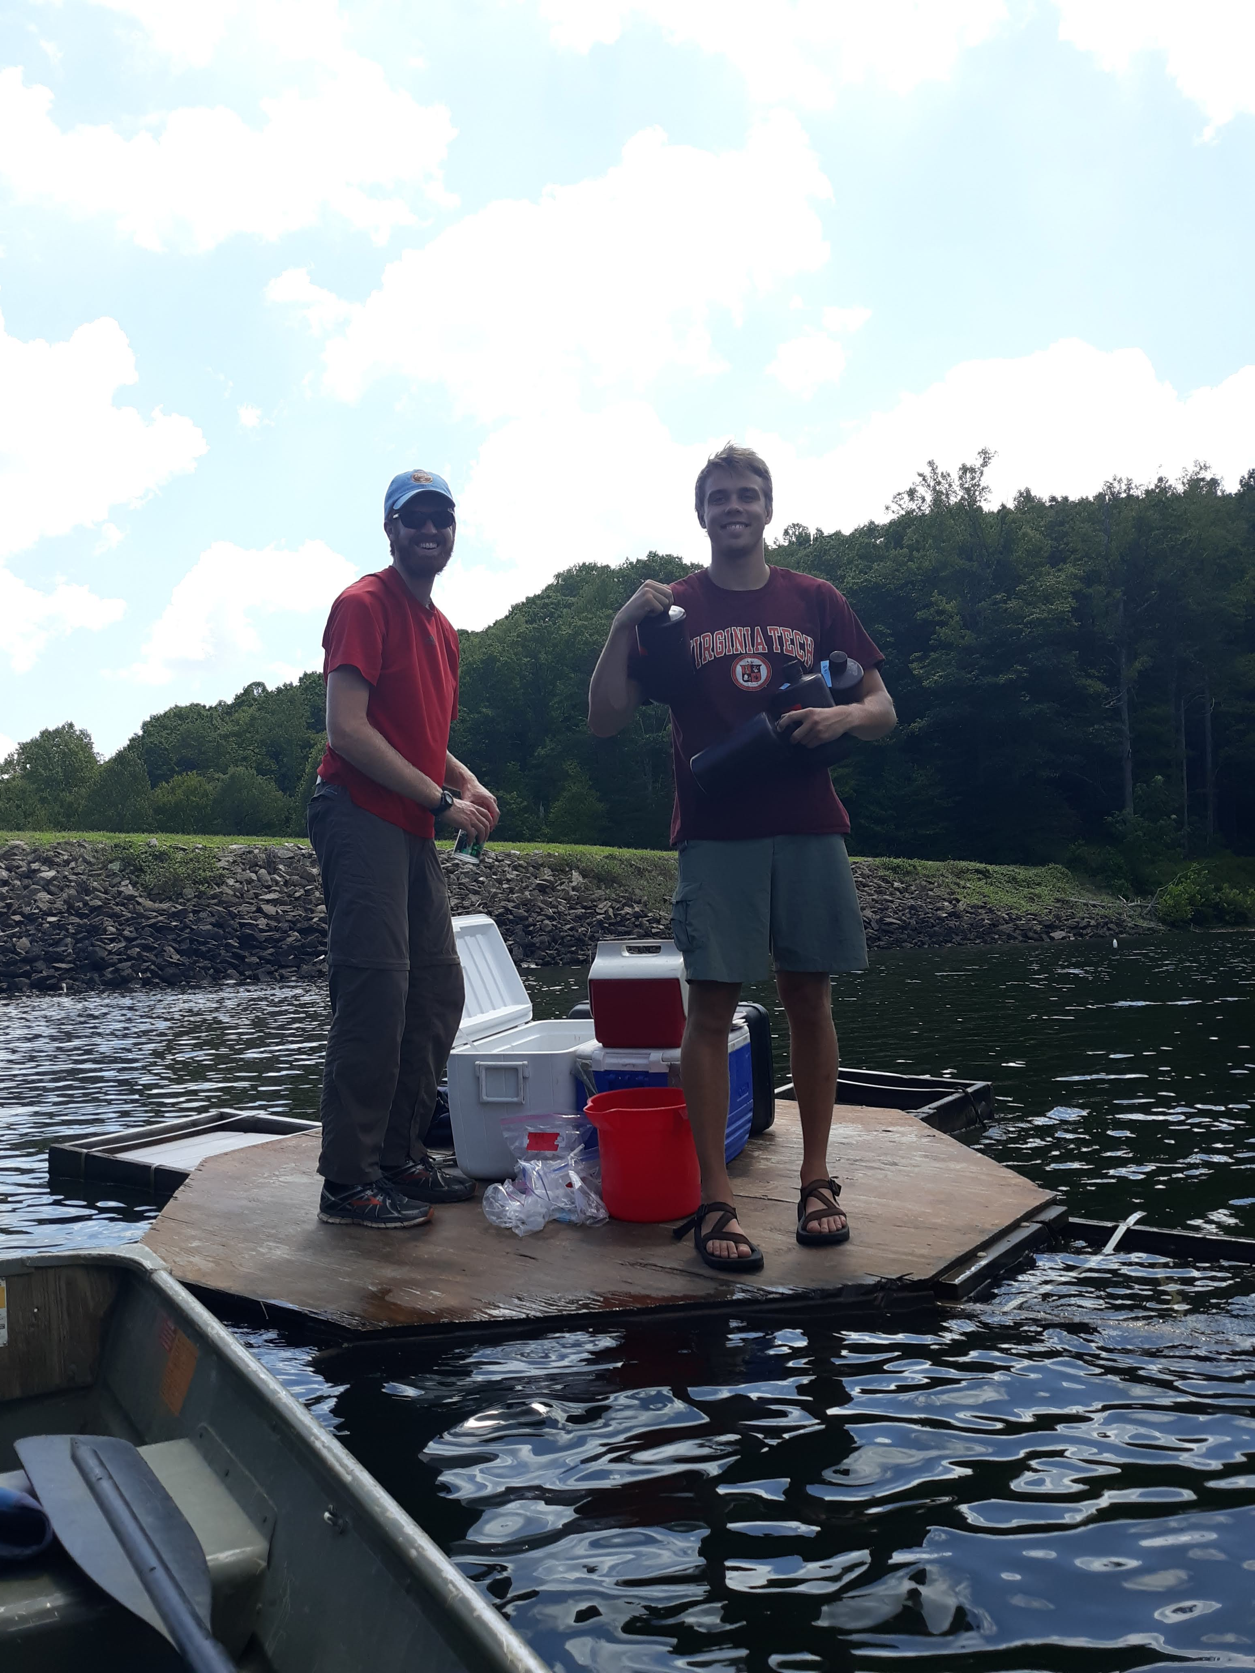
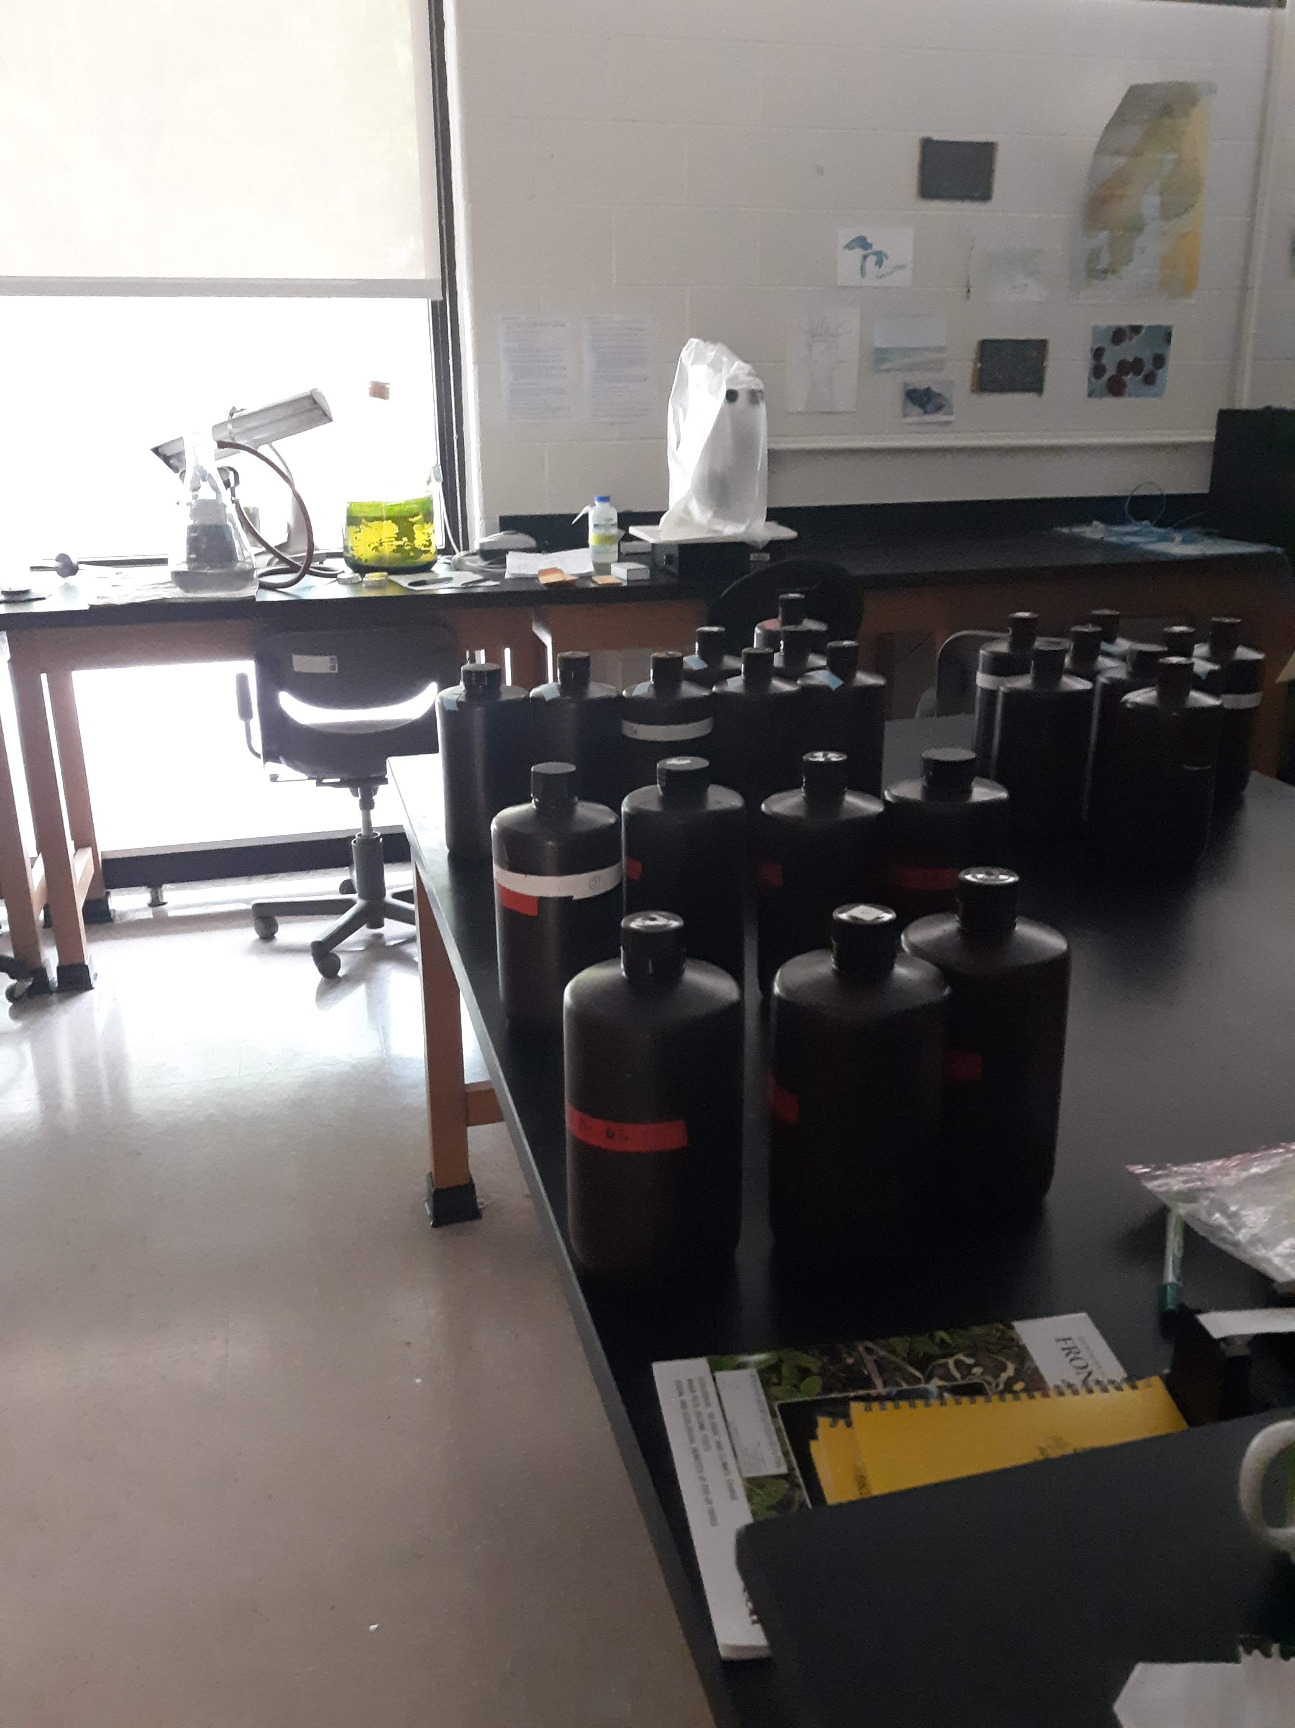
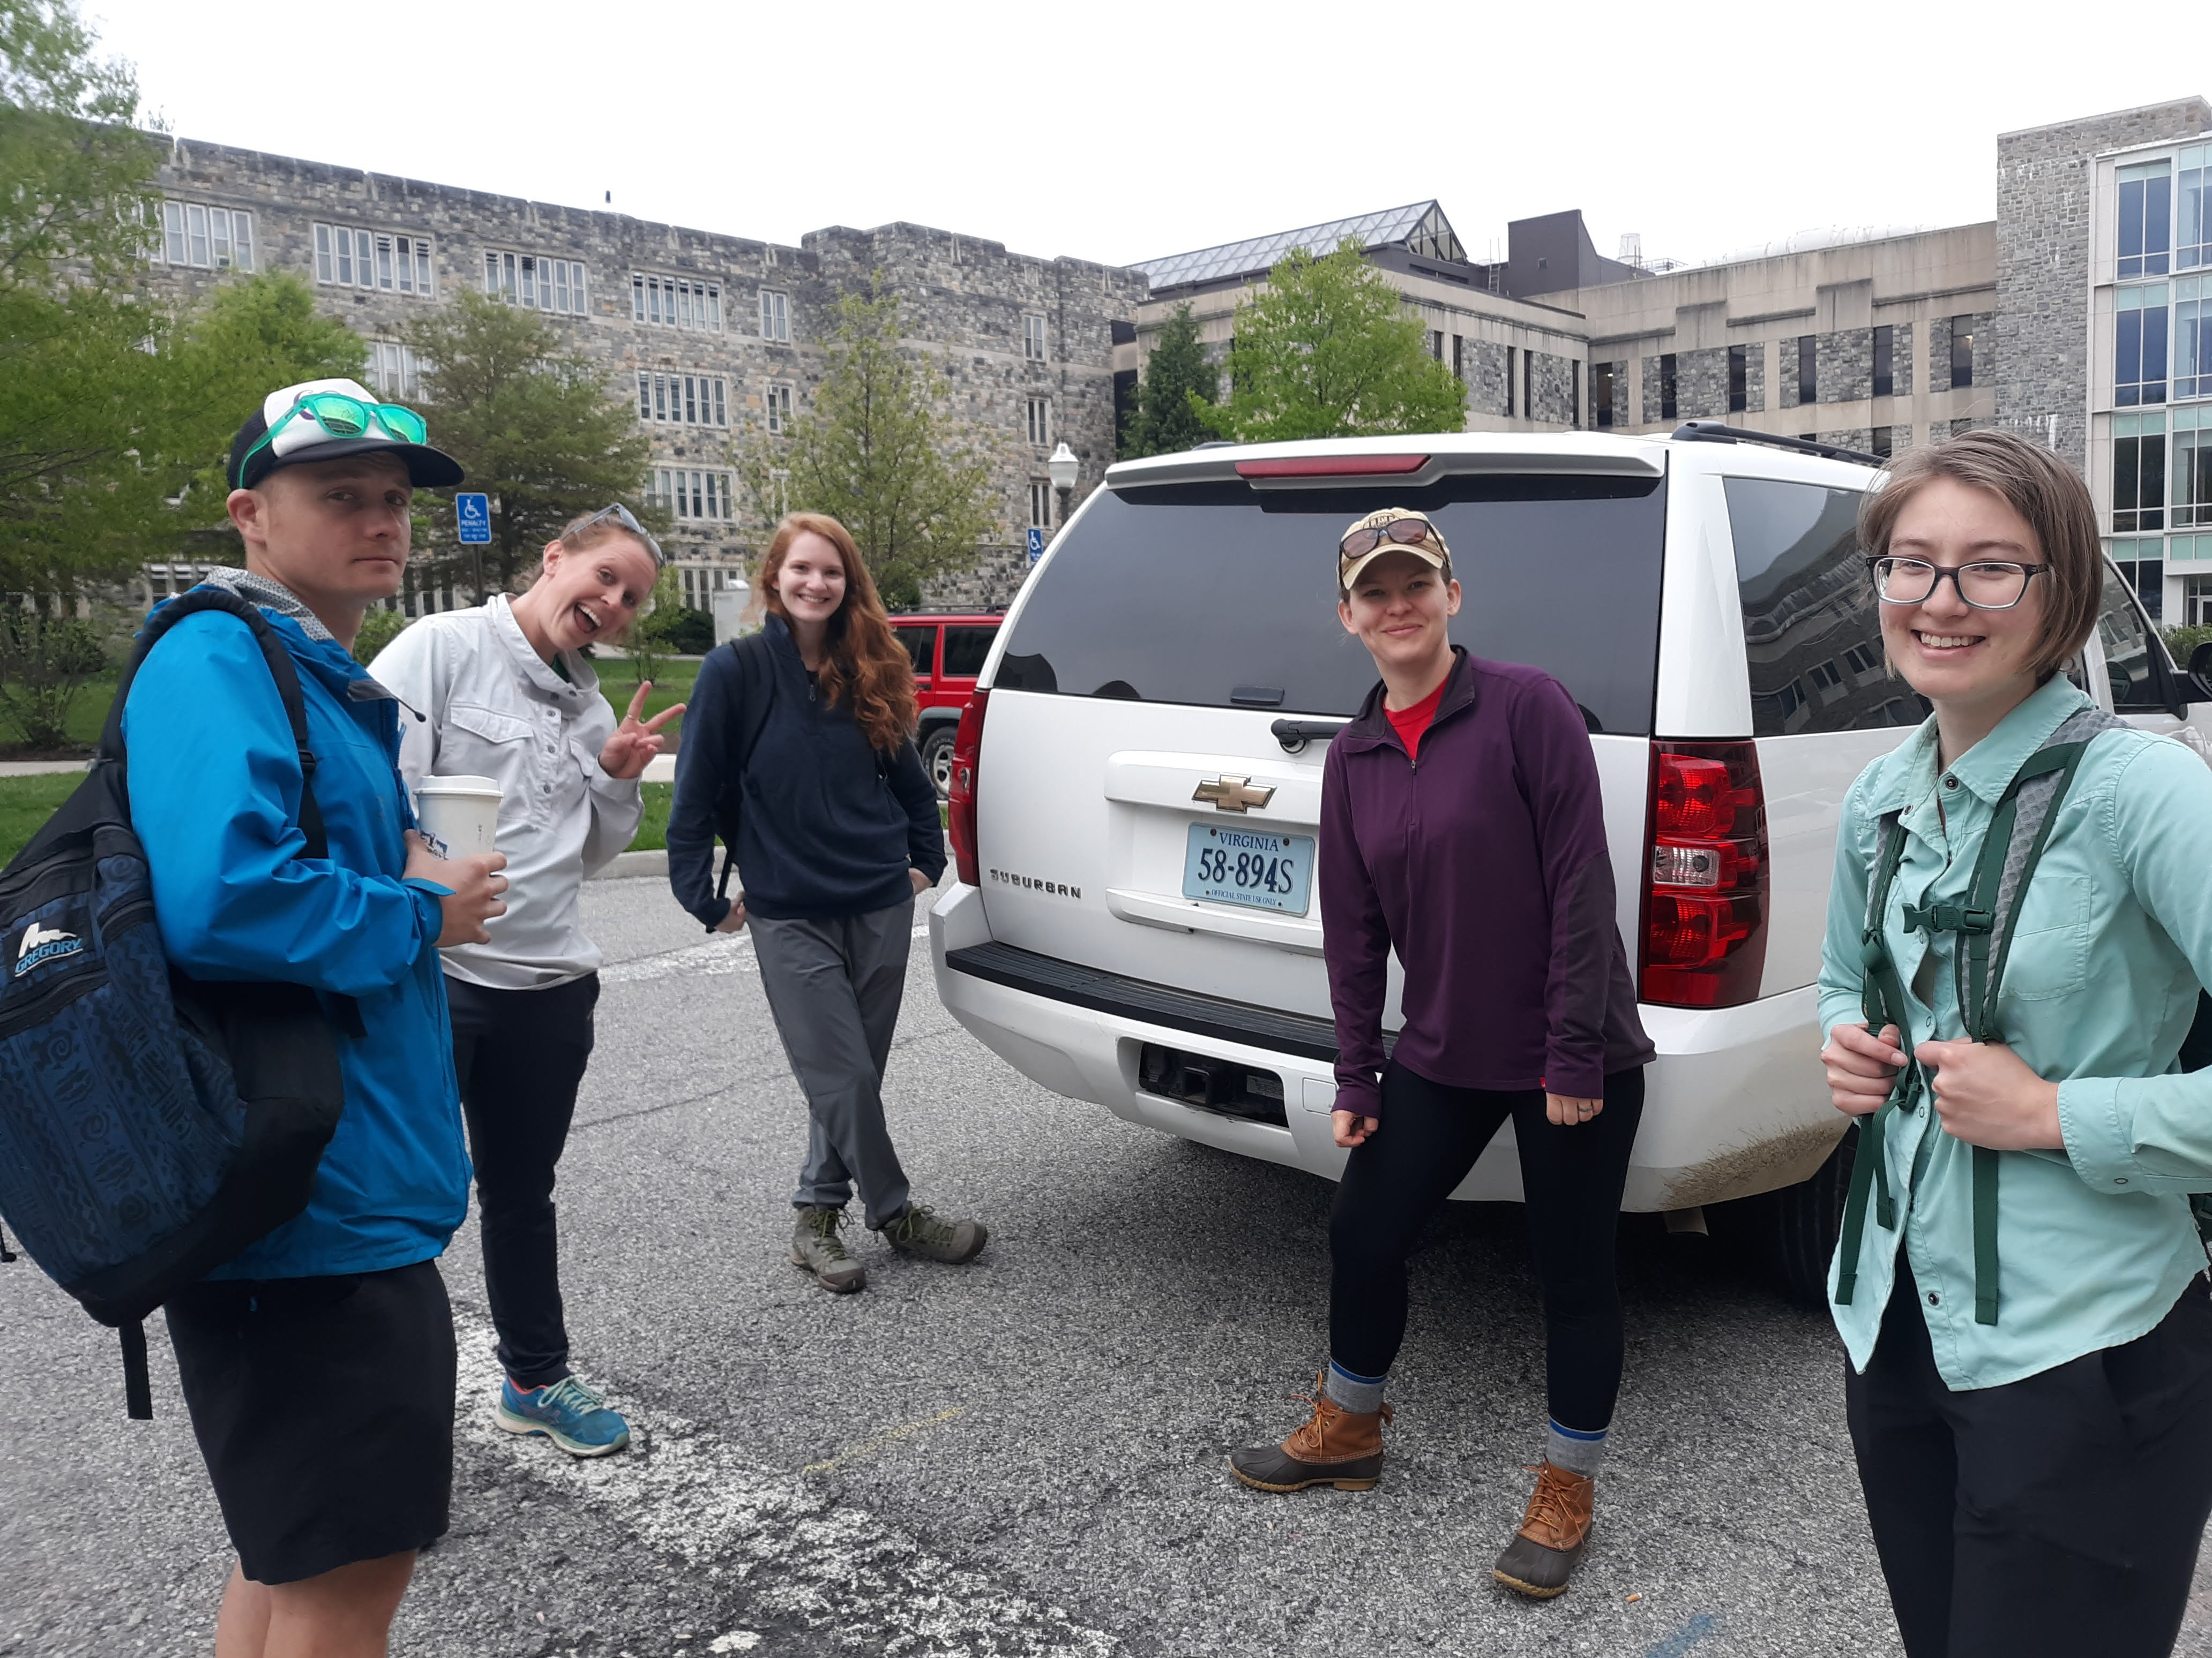
Looooots of field sampling and teamwork!

Slide 18
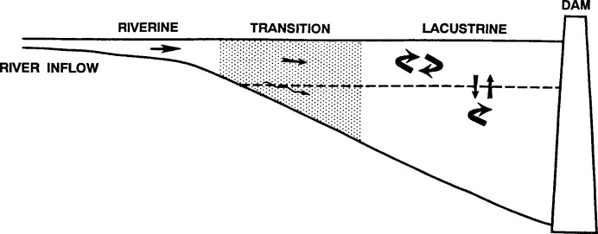
Q1: What is the longitudinal heterogeneity of nitrogen, phosphorus, and chlorophyll-a along a double reservoir continuum?
Chlorophyll-a
Wetzel et al 2001

Slide 19
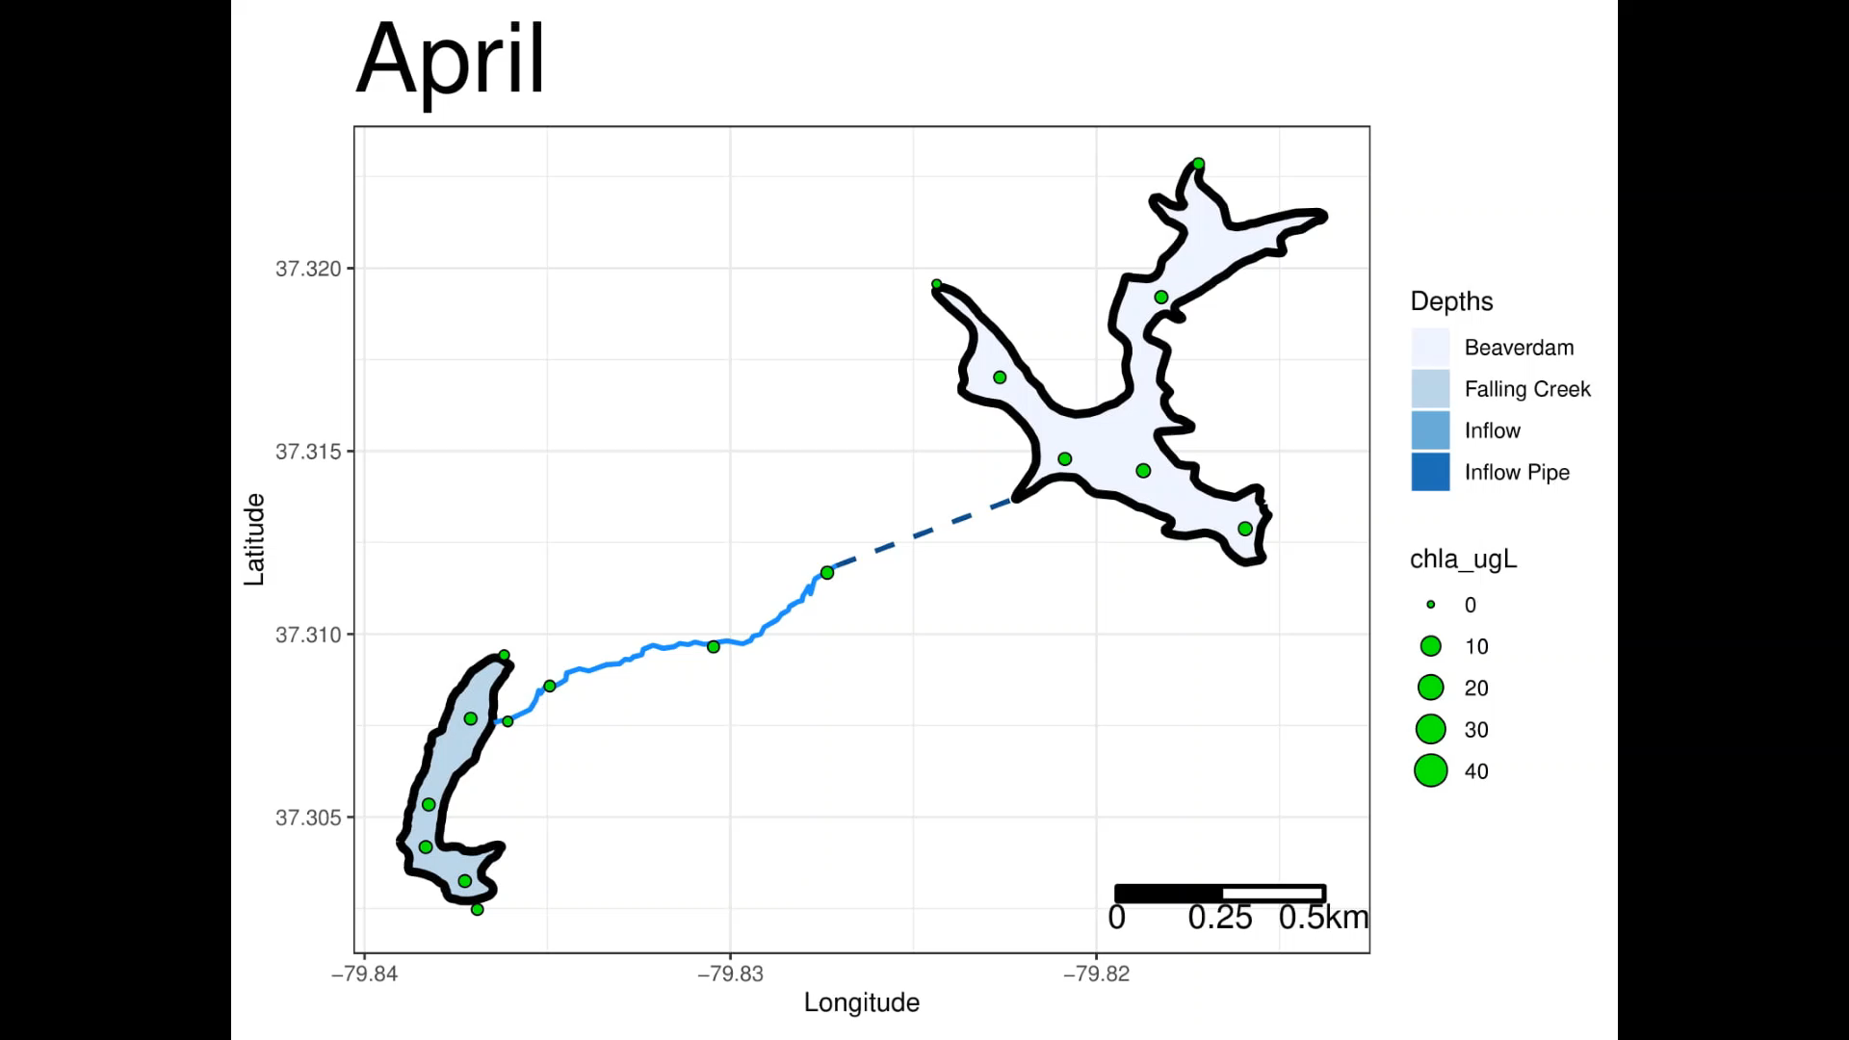
FCR and BVR exhibit seasonal trends and heterogeneity between reservoirs

Slide 20
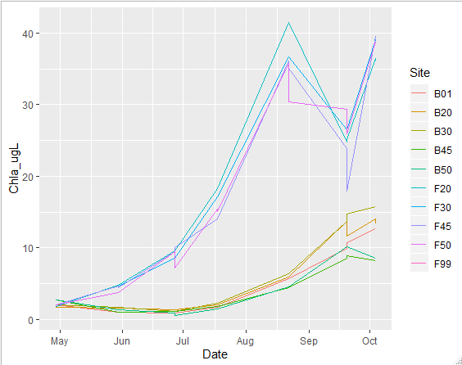
FCR and BVR exhibit similar increasing trend over time but different magnitude in amount of increase
Why?
Met is consistent btw them
Nutrients from inflows forthcoming
FCR receiving nutrients from BVR?
Internal loading?
If anything FCR should have had less loading bc of oxygenation
Residence time?
Working on rough water budgets

Slide 21
Next steps for Chapter 2
Nutrient chemistry analysis and collation
Potential field sampling at high flow informed by nutrient chemistry results
Water residence (trickier for BVR)
Visualizations + analysis

Slide 22
Ch 3: Effective Visualizations of Uncertainty in Forecasts
How do different visual representations of uncertainty of ensemble forecasts of algal concentrations (ug/L) influence comprehension of forecast uncertainty and decision making of water quality managers?
Methods
Managers receive 1 of 5 visualizations
Preliminary survey with WVWA
Qualitative survey of managers across country via NALMS network
Notes:
Clean up bullets

Slide 23

Ch 3: Effective Visualizations of Uncertainty in Forecasts
a) All ensembles shown + forecast mean
b) Mean + CI (extrinsic)
c) Polygon of entire CI (intrinsic)
Chl-a (ug/L)
Chl-a (ug/L)
Time into future
Time into future
d) Animation of forecast mean + CI through time up to present
e) Interactive app that allows user to visualize in multiple ways

Slide 24
Next Steps for Chapter 3
Identify person with expertise in decision support and survey methods
Meeting virtually with Melissa Kenney (U of Minnesota, decision support specialist in EF) in mid-March
Class in survey methods
Developing visualizations
IRB approval
Pre-testing with WVWA

Slide 25
Ch 4 Possibilities
Expanding on Chapter 1 Forecasting
How well can an empirical model and a process-based model forecast near-term phytoplankton dynamics over a 16-day period?
Scaling FLARE to Lake Sunapee:
How well can we forecast near-term phytoplankton dynamics in a large, oligotrophic lake?
What are the major drivers of uncertainty in our forecasts?
Expanding on Chapter 3 Decision Support
3. Do managers vs. scientists differentially perceive visual representations of uncertainty within forecasts of algal bloom densities (ug/L)?
4. Does the comprehension of uncertainty by managers vary between forecast variables? (e.g., binary (presence/absence of bloom) or continuous (concentration of algal biomass) variables)

Slide 26
Next steps Chapter 4
Progress on Chapters 1 and 3 to guide decisions
Developing questions more suited to Sunapee forecasting
Visit to Sunapee in May
Others:
GRIP and GROW opportunities
GRIP: projects with EPA regarding satellite detection + prediction of HABs
GROW: Lisette de Senerpont Domis (GLEON) working on citizen science; others!

Slide 27
Proposed timeline for Chapters 1-4 Gray boxes indicate proposed completion
 | Fall 2019 | Spring 2020 | Summer 2020 | Fall 2020 | Spring 2021 | Summer 2021 | Fall 2021
Final forecast analyses (Ch 1)
Manuscript writing and edits (Ch 1)
Submit Ch 1 to Ecological Applications
Nutrient analyses (Ch 2)
Data analysis (Ch 2)
Manuscript writing and edits (Ch 2)
Submit Ch 2, possible target journals: L&O, Ecosystems, Biogeosciences
Develop visualizations and deliver survey to WVWA (Ch 3)
Analyze initial survey results and disseminate updated survey via NALMS (Ch 3)
Analyze national survey results (Ch 3)
Begin Ch 4 (defining the question) Field work at Sunapee?

Slide 28
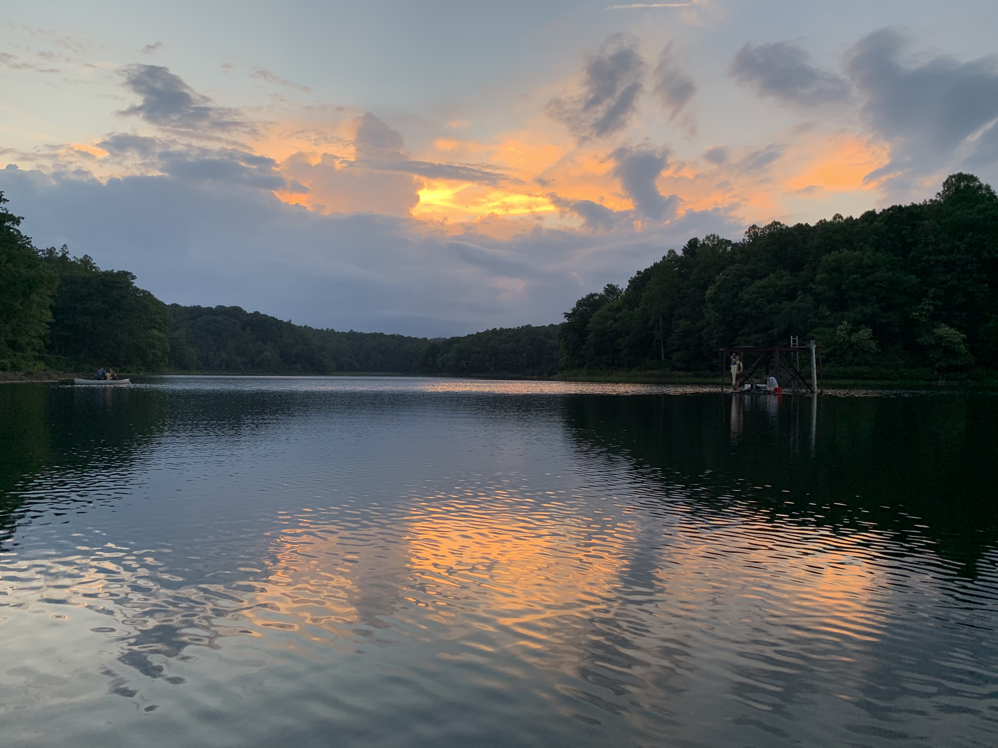
Thank you!

Slide 29
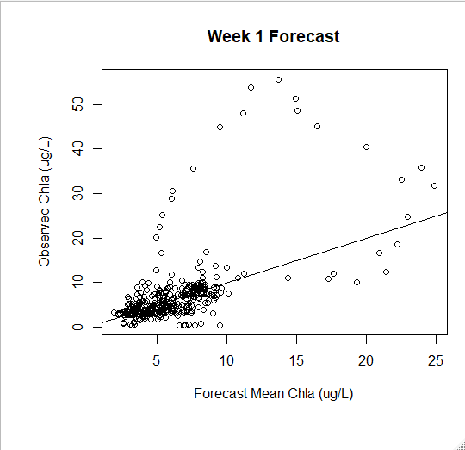
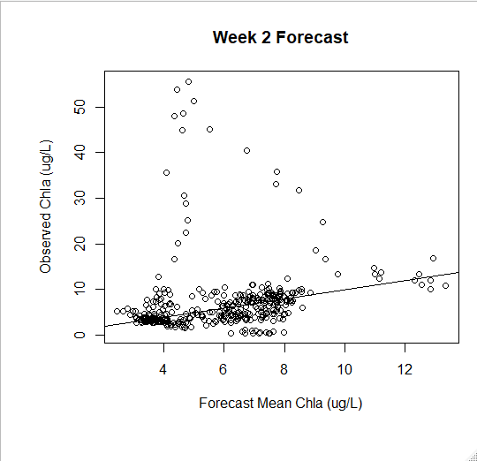

Slide 30
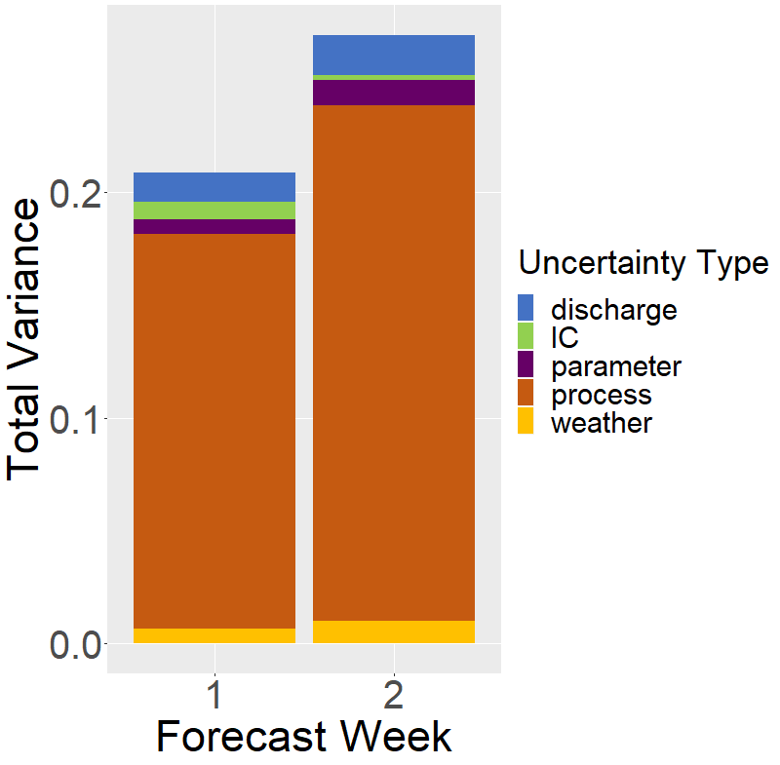
Aug 2018-Oct 2019
July 2019 Bloom

Slide 31
